Slide 1
Thomas Weilacher Chairman ECC Working Group FM
APWPT,
Berlin, 21 June 2017
1

Slide 2
Structure of the ECC
Structure of the ECC
Electronic
Communications Committee
Chairman: E. Fournier (F)
Vice-Chairmen: S. Pastukh (RUS) J. Afonso (POR)
Steering Group
European
Communications Office
Director: P. Christensen (DNK)
Deputy Director: B. Espinosa (F)
WG CPG
WG FM
WG SE
WG NaN
ECC PT1
Conference
Preparatory Group
Frequency
Management
Spectrum
Engineering
Numbering
and Networks
IMT-Matters
Chairman:
A. Kühn (D)
Vice-Chairman:
G. Osinga (HOL) A. Vallet (F)
Chairman:
T. Weilacher (D)
Vice-Chairmen:
L. Bodusseau (F)
S. Talbot (G)
Chairman:
K. Loew (D)
Vice-Chairmen:
J. Duque (POR) k. Bejuk (HRV)
Chairman:
J. Vallesverd
(NOR)
Vice-Chairman:
E. Greenberg (G)
F. Dragomir (ROU)
Chairman:
S. Green (G)
Vice-Chairmen:
D. Guiducci (I)
Berlin, 21 June 2017
2

Slide 3
LoU ECC / APWPT
The ECC is working with a range of partners and sharing best practice and knowledge.
CEPT/ECC has a number of external partners, based on a formal agreement (LoU or MoU).
LoU between ECC and APWPT signed in 2009.
Major elements (for both sides): - exchange of information (free of charge), - access to working documents, - participation in meetings, - possibility to provide written contributions.
Berlin, 21 June 2017

Slide 4
LoU ECC / APWPT
Examples (APWPT support to ECC)
Compatibility and sharing studies (ECC Reports); WG SE, SE7, SE24.
Regulatory studies (ECC Reports); WG FM, FM51.
Development of frequency regulations (ECC Decisions, ECC Recommendations); e.g. REC 25-10, REC 70-03 (Annex 10).
Development of CEPT Reports (responses to Mandates from the European Commission).
Update of ECA Table (ERC Report 25).
CEPT contributions to ITU-R meetings.
Berlin, 21 June 2017

Slide 5
LoU ECC / APWPT
Current activities within ECC (related to PMSE)
Low power audio PMSE in the band 960 – 1164 MHz.
Body effect of handheld and body worn audio PMSE equipment.
Best practises for video PMSE in the 2.7 – 2.9 GHz band.
Contributions to ITU-R WP 5C.
Berlin, 21 June 2017

Slide 6
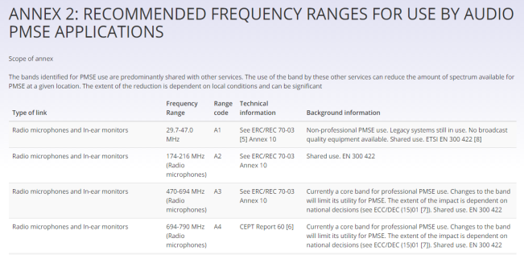
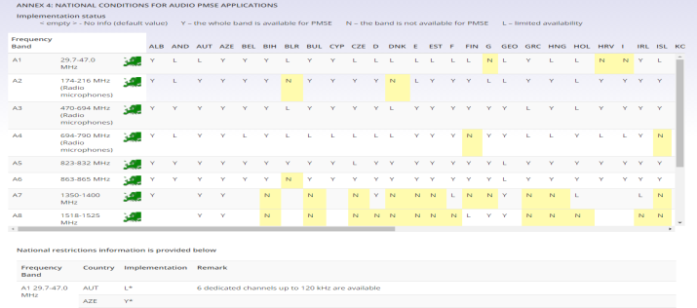
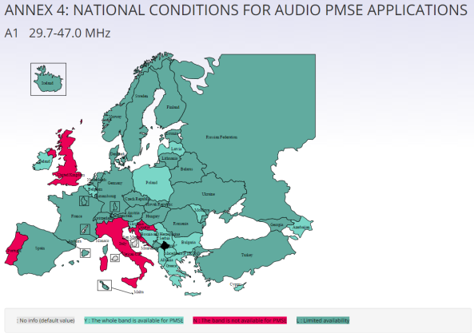
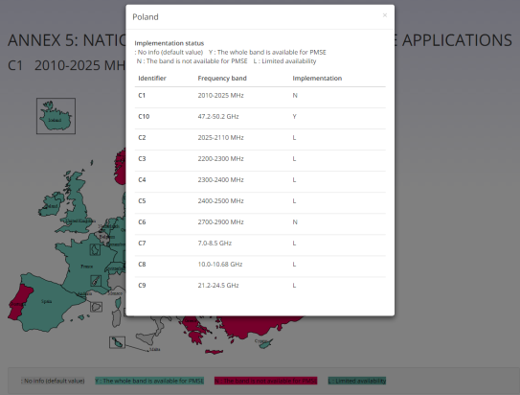
Information on PMSE use in Europe
PMSE module in EFIS: http://www.efis.dk/views2/pmserec2510.jsp
Content and related national information from REC 25-10
Berlin, 21 June 2017

Slide 7
LoU ECC / APWPT
Thank you very much
Further information on: www.cept.org/ecc
ECC PMSE webpage
Berlin, 21 June 2017

